Slide 1
CACHE EVOLUTION
Current Cache Design

Slide 2
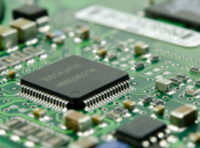
CURRENT CACHE design
In computing, a cache is a hardware or software component that stores data so that future requests for that data can be served faster; the data stored in a cache might be the result of an earlier computation or a copy of data stored elsewhere. A cache hit occurs when the requested data can be found in a cache, while a cache miss occurs when it cannot. Cache hits are served by reading data from the cache, which is faster than recomputing a result or reading from a slower data store; thus, the more requests that can be served from the cache, the faster the system performs.

Slide 3
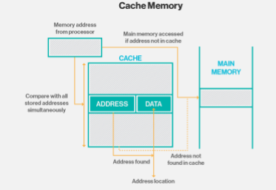
Working of cache memory

Slide 4
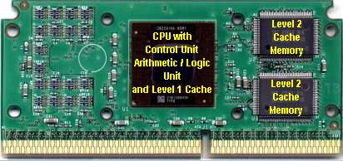
The cache stores the frequently used data by the CPU. The CPU ﬁrst checks the cache for the required data. Even though the RAM is fast, it is not as fast as the cache. Therefore, storing the commonly required data in the cache is beneﬁcial to increase the computation speed.
There are three types of cache. The level 1 cache is the smallest. It is located inside the CPU or the processor. So, it runs at the same speed as the CPU. Level 2 and level 3 caches are external. Level 2 cache is larger than level 1 cache. If the required data is not available in level 1 cache, the CPU checks the level 2 cache. If the required data is not available in both level 1 and level 2 caches, the CPU checks the level 3 cache. If the required data is not available in any of these caches, the CPU will access the RAM. Level 1 cache is the fastest cache of all. A CPU can have multiple cores. A core is the execution unit of the CPU. Each core can have separate level 1 and level 2 caches. The level 3 cache is shared among all cores

Slide 5
THANKYOU
Sourabh Singh

